Slide 1
Trigonometry
MATH SUBJECT
GROUP 13

Slide 2


SHAFA RAFAZANDA
22
2241720243
DHIO FEBRIO ATHLON
07
2241720125

Slide 3
Table of contents
01
02
03
04
05
06
Introduction
Special right triangles
Angle Relationship in quadrilaterals trigonometry
Negative Angle
More Than 360° angle
Trigonometry Identities

Slide 4
01
Introduction

Slide 5

Introduction
The word trigonometry comes from the Greek words trigonon (“triangle”) and metron (“to measure”). Until about the 16th century, trigonometry was chiefly concerned with computing the numerical values of the missing parts of a triangle (or any shape that can be dissected into triangles) when the values of other parts were given.

Slide 6
Law of sines, cosines, & tangent
Sin θ =
Opposite
Hypotenuse
Cos θ =
Tan θ =
Adjacent
Opposite
Hypotenuse
Adjacent
Hypotenuse
Opposite
Adjacent

Slide 7
Law of cosecant, secant, & cottangent
Cosec θ =
=
Opposite
Hypotenuse
=
Sec θ =
Cot θ =
=
Adjacent
1
Hypotenuse
Sin θ
Opposite
1
Hypotenuse
Cos θ
Adjacent
1
Adjacent
Tan θ
Opposite

Slide 8

02
Special right triangles

Slide 9
What are special right triangles?
The special angles used in trigonometry are 0°, 30°, 45°, 60° and 90°. These are the common angles which are used while performing computations of trigonometric problems. Hence, it is suggested for students to memorise the values of trigonometric ratios (sines, cosines and tangent) for these angles, to do quick calculations.
45-45-90 triangle
30-60-90 triangle
45°
60°
45°
30°

Slide 10
Special Right Trigonometry value
Angle (in Degrees) | 0° | 30° | 37° | 45° | 53° | 60° | 90°
sin | 0 | 1/2 | 3/5 | 1/√2 | 4/5 | √3/2 | 1
cos | 1 | √3/2 | 4/5 | 1/√2 | 3/5 | 1/2 | 0
tan | 0 | √3/3 | 3/4 | 1 | 4/3 | √3 | ∞

Slide 11
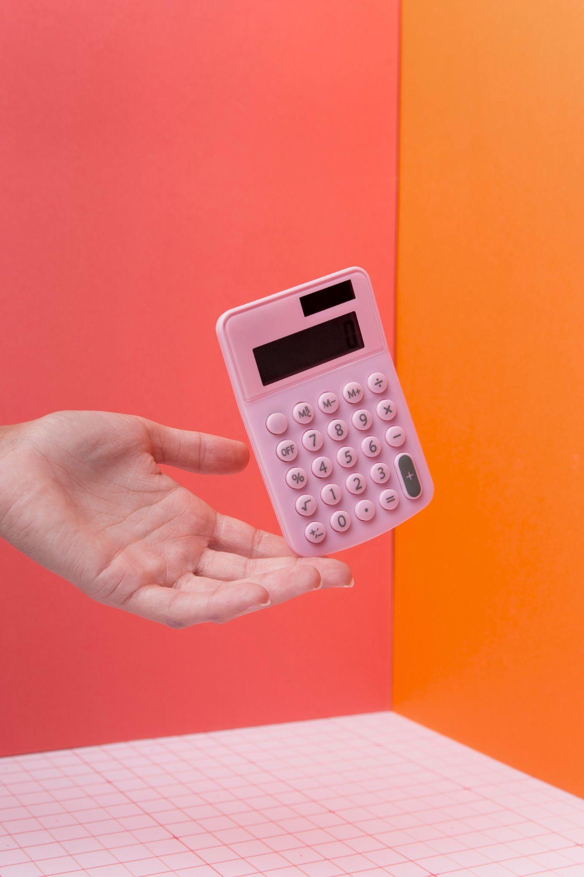

03
Angle Relationships in Quadrilaterals Trigonometry

Slide 12
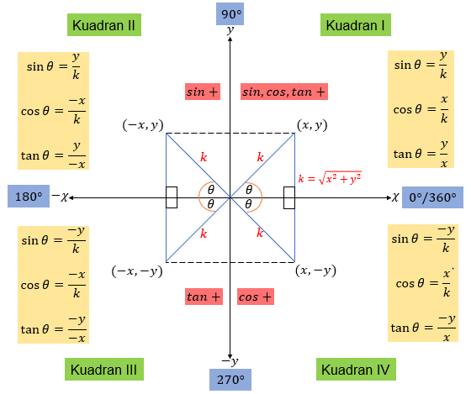

Quadrant I (0° − 90°) = both positive.
Quadrant II (90° − 180°) = positive sin .
Quadrant III (180° − 270°) = positive tan .
Quadrant IV (270° − 360°) = positive cos .

Slide 13
In principle, sin will be positive if y is positive. If x is positive, cos will be positive. The value of tan will be positive if x and y are both positive or negative. Lastly, the value of k will always be positive.

Slide 14

04
Negative Angle

Slide 15
The angles could be positive or negative in nature. If the angle is formed in a counterclockwise direction from the start point in an x-y plane, then it is positive and if the angle is formed in a clockwise direction from the start point then it is a negative angle.

Slide 16
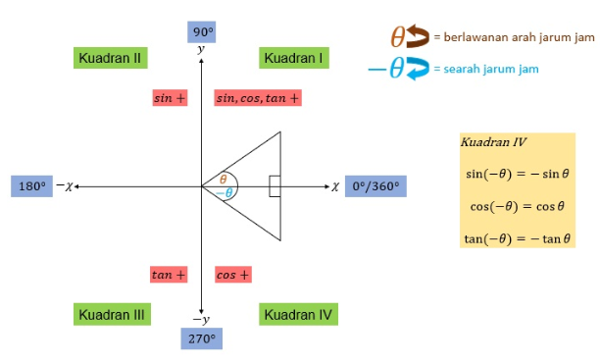
Negative Angle Trigonometry

Slide 17
05
More than 360° angle

Slide 18
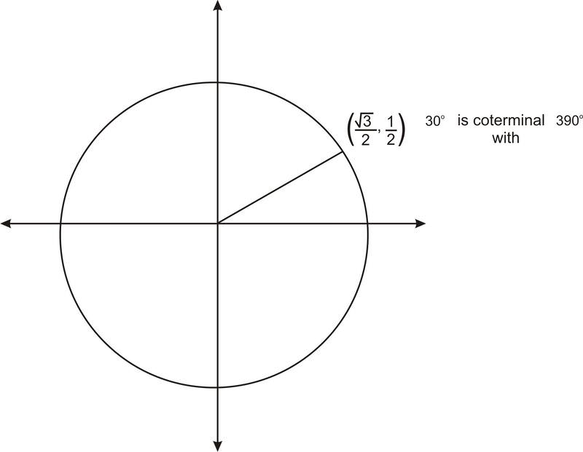
More Than 360° Angle
Consider the angle 390° . As you learned previously, you can think of this angle as a full 360 degree rotation, plus an additional 30 degrees. Therefore 390° is coterminal with 30° . As you saw above with negative angles, this means that 390° has the same ordered pair as 30° , and so it has the same trig values. For example,
In general, if an angle whose measure is greater than 360° has a reference angle of 30° , 45° , or 60° , or if it is a quadrantal angle, we can find its ordered pair, and so we can find the values of any of the trig functions of the angle. Again, determine the reference angle first.

Slide 19
More Than 360° Angle
example
Find the value of the expression: sin570∘
Solution: Since 570∘ has the same terminal side as 210°, sin 570°= sin 210° = -1/2

Slide 20
06
Trigonometry Identities

Slide 21
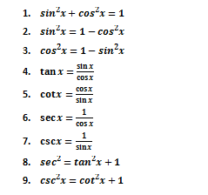
trigonometric identities
All the trigonometric identities are based on the six trigonometric ratios. They are sine, cosine, tangent, cosecant, secant, and cotangent. All these trigonometric ratios are defined using the sides of the right triangle, such as an adjacent side, opposite side, and hypotenuse side. All the fundamental trigonometric identities are derived from the six trigonometric ratios.

Slide 22
Example
example 1
In a right triangle ABC, tan(A) = 3/4. Find sin(A) and cos(A)!
Solition : Let a be the length of the side opposite angle A, b the length of the side adjacent to angle A and h be the length of the hypotenuse.
tan(A) = opposite side / adjacent side = a/b = 3/4
We can say that: a = 3k and b = 4k , where k is a coefficient of proportionality. Let us find h.
Pythagora's theorem: h2 = (3k)2 + (5k)2
Solve for h: h = 5k
sin(A) = a / h = 3k / 5k = 3/5 and cos(A) = 4k / 5k = 4/5

Slide 23
Example
example 2
The lengths of side AB and side BC of a scalene triangle ABC are 12 cm and 8 cm respectively. The size of angle C is 59°. Find the length of side AC!
Solution : Let x be the length of side AC. Use the cosine law
122 = 82 + x2 - 2 · 8 · x · cos(59°)
Solve the quadratic equation for x: x = 14.0 and x = - 5.7
x cannot be negative and therefore the solution is x = 14.0 (rounded to one decimal place).

Slide 24
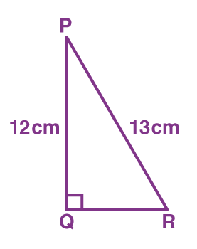
Example
example 3
From the given figure, find tan P – cot R!
Solution : From the given,
PQ = 12 cm, PR = 13 cm
In the right triangle PQR, Q is right angle.
By Pythagoras theorem, PR² = PQ² + QR²
QR² = (13)² – (12)² = 169 – 144 = 25
QR = 5 cm, tan P = QR/PQ = 5/12
cot R = QR/PQ = 5/12
So, tan P – cot R = (5/12) – (5/12) = 0

Slide 25

Thanks
Do you have any questions?

